Slide 1

How to make your customers happy
business case
Notes:
For my final project I wanted to do something related to Marketing and I found this interesting data from Olist
Main goal ←- explain and predict customers satisfaction

Slide 2

Data and Goal
Olist: the “brazilian Amazon”
Data: Kaggle(Olist Marketing Funnel + Brazilian e-commerce)
Goal: Understand what makes Olist´s customers happy and find a model to predict their level of satisfaction
Notes:
Olist -> reseller, basically similar to Amazon, operates only in Brazil

Slide 3
Steps of my analysis
EDA
Creating and dropping variables
Unsupervised analysis: Cluster analysis
Supervised analysis:
Linear Regression Model
Ordinal Logistic Regression Model
Machine Learning Model
Conclusions

Slide 4
EDA (Dimensions reduction)
Reason | #dropped variables | comments
Identifier | 9
Date | 11 | Created new variables
Text | 3 | Sentiment analysis
Unknown or irrelevant | 2
Too many levels | 1 | Tried to group
Low variance | 1
Most of obs in one level | 3
High % missing values | 7

Slide 5
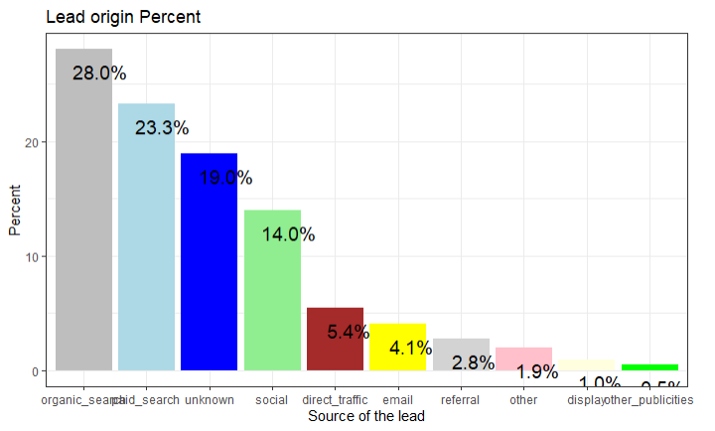
EDA (Insights from dropped variables)
Notes:
Before dropping - gain some insight from this data
Origin of the lead
Lead: a potential customer that is attracted to the website
Organic and Paid search together represent > 50%

Slide 6
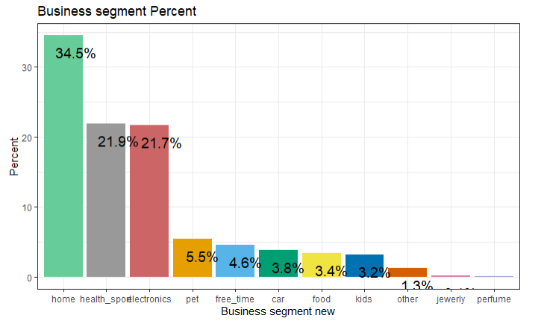
EDA (Insights from dropped variables)
Notes:
2. Business segment of the products sold through Olist.
This is after I grouped the original levels into a reduced number of levels
Most popular products are in the categories home, health & sports and electronics.

Slide 7
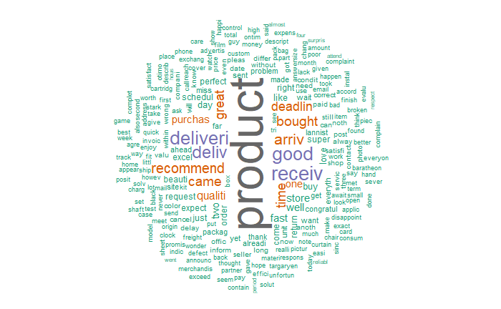
EDA (Insights from dropped variables)
Notes:
3. From the reviews comments
Some misspelling because of the translation
Most popular words in reviews: Product, good, delivered, received, great, quality

Slide 8
EDA (Final variables)
Final variables
Variable name | Description | Scale
Review score | Satisfaction level of the customer | 1 to 5 (1=very upset, 5= very satisfied)
Price | Price of the item bought | Brazilian Real
Freight | Transport costs | Brazilian Real
Delivery time | Delivered - purchased | days
Feedback time | Wrote review - purchased | days
Delay time | Actual Delivery time- ETA | days
Approval time | Approved - purchased | days
Sentiment score | From the review comments | -1 to 2
Notes:
Review score ←- dependent variable (measure customer´s satisfaction)

Slide 9
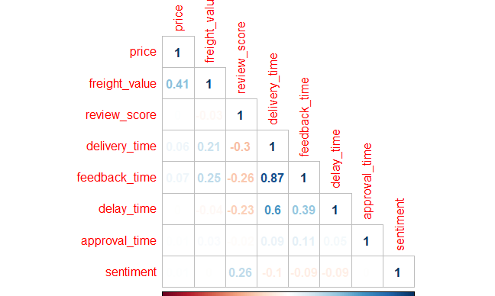
EDA (Correlation Matrix)
Notes:
Makes sense, normally the review is not given until the product is delivered
Not over 0.95, so I kept both

Slide 10
EDA (highlights)
Too many missing values
From 37 ---> 8 variables
From 121k ---> 110k observations
High correlation between the delivery time and the feedback time

Slide 11
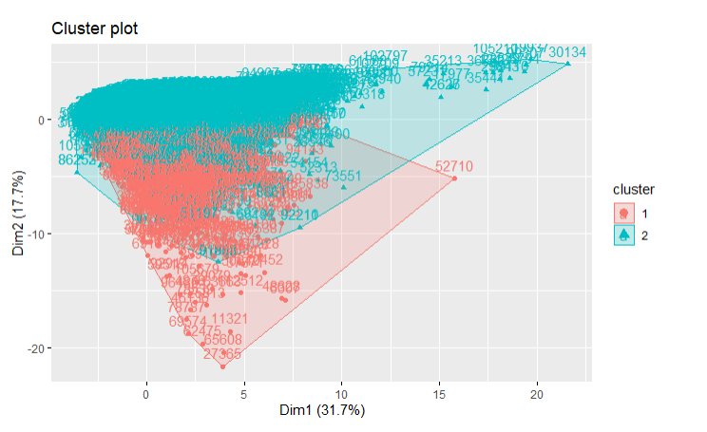
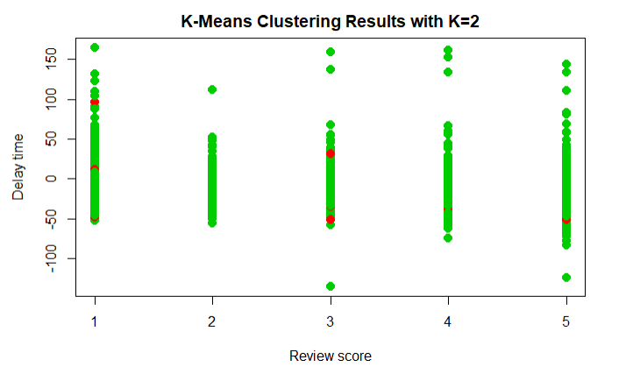
Cluster analysis
Notes:
Very briefly.
Taking into account the 2main dimensions behind the data, 2 clusters, but the majority seems to be in the common area of the 2 clusters, so not very insightfull

Slide 12
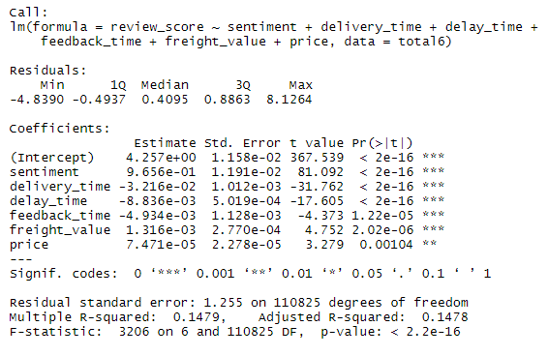
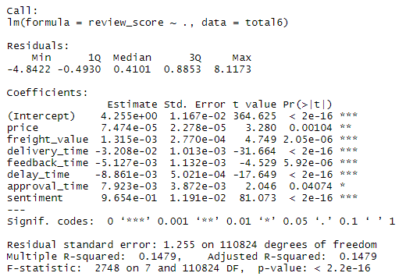
Lineal Regression Model
Notes:
Supervised analysis:
Treated the Y as numeric

Slide 13
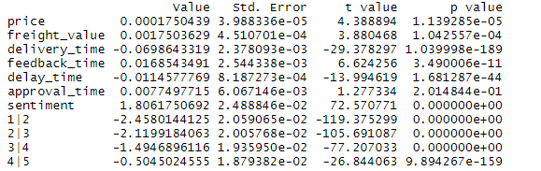
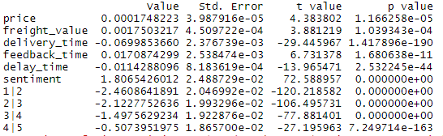
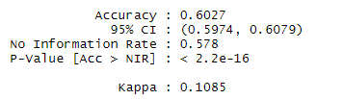

Ordinal Logistic Regression Model
Notes:
2. Treated the dependent variable as a categorical ordinal variable (its real nature)
After applying stepAIC, approval time is dropped
Interpretation:
.
#As our predictive variables are continuous they can be interpreted as: E.g. With 1 day increase in the delivery time the log of odds of a customer giving a better review score decreases by 0.069
#The intercepts can be interpreted in the following way: E.g. 1|2 means the log of odds of giving a review of 1, versus giving a review of 2,3,4 or 5.

Slide 14
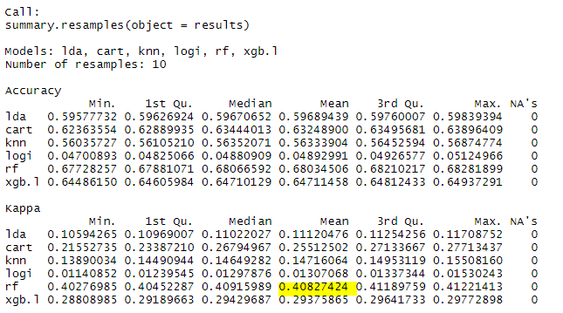
Machine Learning Modelling

Slide 15
Conclusions
Choose Ordinal Logistic model over the Random Forest for interpretation reasons
Found a model to predict customer´s satisfaction with a 60% of accuracy
Both, the lineal and the logistic regression show that the less relevant variable to predict customer satisfaction is the approval time followed by the price of an item
The variable that affect the most a customer's satisfaction is the delivery time (negatively related)

Slide 16

Thank you!

